Slide 1


Empirical Asset Pricing via Boosting Algorithm on China’s A-share market
Mengxuan Chen
chenmx19@mails.Tsinghua.edu.cn
12/10/2019

Slide 2

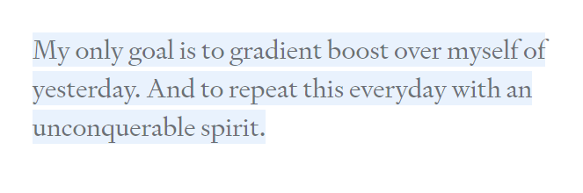
From “A Kaggle Master Explains Gradient Boosting”

Slide 3
THE MAIN CONTENTS
01
Introduction
02
Methodology
03
Empirical study
04
Conclusion

Slide 4
Introduction
Machine learning algorithm can effectively capture the complex correlation between factors and better handle multi-dimensional data in asset pricing models.
This research aims at :
checking the effectiveness of the anomalies of stock market researched by previous scholars in China’s A share market;
Applying Boosting algorithms to the cross-sectional prediction of stock risk premium.
Algorithms includes:
Extremely Randomized Forest, Gridant Boosting Regreesion(GBRT), XGBoost and lightBGM

Slide 5
Introduction: literature
Fama and French (2008) | The first strand models differences in expected returns across stocks as a function of stock level characteristics
Stambaugh, Yu, and Yuan（2012） | use 11 factors related to the emotions of investors
Lewellen（2013） | use 15 factors and found 12 months is the best time window
McLean, and Pontiff（2016） | use 93 factors, and found 23 of them were colinear
Green. etal（2017） | use 330 factors in 40 years and improved the results by normalization
Hou, Xue and Zhang（2017） | use 447 factors and found only 3/4 of the previous research exaggerate the results
Harvey and Liu (2016) | study the multiple comparisons problem using a bootstrap procedure.
Serhiy（2017） | use GMM to improve Fama French 5 factors
Giglio and Xiu (2016) and Kelly et al. (2017) | use dimension reduction methods to estimate and test factor pricing models.
Kozak et al. (2017) and Freyberger et al. (2017) | use shrinkage and selection methods for stochastic discount factor and a nonlinear function for expected returns.
Feng, Polson, Xu（2018） | generate alphas with deep learning methods
Gu, Kelly, Xiu（2018） | use multiple machine learning methods in cross section stock prediction
Linear assumption fails for highly correlated and high-dimensional predictors!

Slide 6
Methodology: framework
Sample begins in December 1996 and ends in November 2018 for all firms listed in SH Exchange and SZ Exchange ①except the financial stocks, ②ST and ST* stocks, ③firms that go public within a year. Fill in the missing financial report data with the latest reachable one. Normalize the features within a single section.
Factor of 1996/12
Excess Return of 1997/1
Test set
1
Factor of 1997/1
Excess Return of 1997/2
model1
……
Factor of 2017/9
Excess Return of 2017/10
Test set
n
……
……
……
……
Model n
Factor of 1997/12
Excess Return of 1998/1
Factor of 2018/8
Excess Return of 2018/9
1997/1-1998/1
1998/2
Factor of 2018/9
Excess Return of 2018/10
2017/10-2018/10
2018/11
Notes:
It’s the beginning of the price limit in china.
N=262

Slide 7
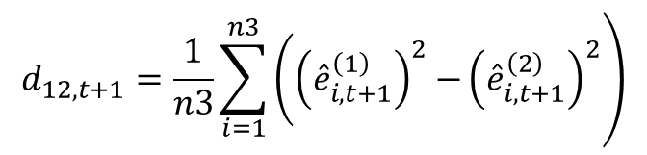
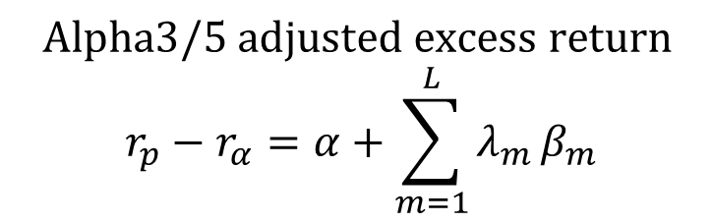
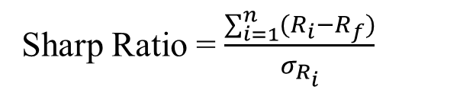
Methodology: model evaluation& comparison
Get the long-short portfolio;
Sliding the time window to form the back-test results of the portfolio;
Calculate the relative investment performance indexes.
Check if these models exist distinguished difference by Diebold Mariano test
Factor of 1996/12
Excess Return of 1997/1
Test set
1
Factor of 1997/1
Excess Return of 1997/2
model1
……
……
Factor of 1997/12
Excess Return of 1998/1
Sharp Ratio = $\frac{\sum_{i=1}^{n}{(R_{i}−R_{f})}}{σ_{R_{i}}}$
1997/1-1998/1
1998/2
$$Alpha3/5 adjusted excess return$$
$$r_{p}−r_{α}=α+\sum_{m=1}^{L}{λ_{m}}β_{m}$$
Test set
1
Predicted Excess Return
1
Long leg (equal weighted)
2
…
9
Short leg
(equal weighted)
$$\left.d_{12,t+1}=\frac{1}{n3}\sum_{i=1}^{n3}{\left({\left({\hat{e}}_{i,t+1}^{\left(1\right)}\right)}^{2}−\right.}{\left({\hat{e}}_{i,t+1}^{\left(2\right)}\right)}^{2}\right)$$
10
Notes:
市场风险溢价因子（Market Risk Premium）、市值因子（SMB）、账面市值比（HML）、盈利能力因子（RMW）、投资模式因子（CMA）；Null Hypothesis原假设; n3, samples in the test set

Slide 8
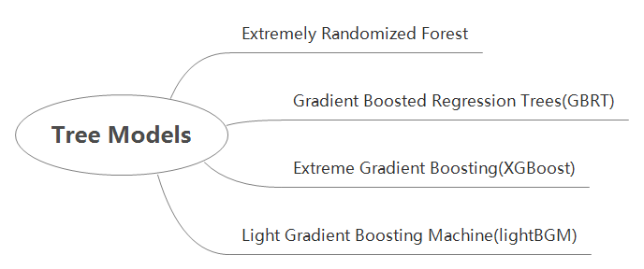
Methodology: algorithm
Notes:
It’s the beginning of the price limit in china.
N=262

Slide 9
Empirical study: Which Covariates Matter?(2)
ranking | name | times | explanation | category | author | publishing
1 | aeavol | 15 | Average daily trading volume (vol) for 3 days around earnings announcement minus average daily volume for 1-month ending 2 weeks before earnings announcement divided by 1-month average daily volume. Earnings announcement day from Compustat quarterly (rdq) | trading friction | Lerman, Livnat, and Mendenhall | 2008
2 | mom12 | 15 | 11-month cumulative returns ending one month before month end | momentum | Jagadeesh | 1990
3 | age | 12 | Number of years since first Compustat coverage | trading friction | Jiang, Lee and Zhang | 2015
4 | Sgr | 12 | Annual percent change in sales (sale) | growth | Lakonishok, Shleifer,& Vishny | 1994
5 | roic | 12 | Annual earnings before interest and taxes (ebit) minus nonoperating income (nopi) divided by non-cash enterprise value | profitability | Brown and Rowe | 2007
Notes:
pick the top 20 most important factors in each models and show the rank of each factors that are picked by our models most of the time.

Slide 10
Empirical study: Diebold Mariano test
How could Boosting models improve the investment from traditional methods?
 | FM | EXT | GBRT | XGB | lightBGM
FM | 1 | 0.6764 | 0.6793 | 0.6822 | 0.6789
EXT |  | 1 | 0.9795 | 0.9807 | 0.9764
GBRT |  |  | 1 | 0.9846 | 0.9912
XGB |  |  |  | 1 | 0.984
lightBGM |  |  |  |  | 1
There’s no significant difference between these models.

Slide 11
Conclusion
For portfolio formation:
Multifactor models outperform single-factor models;
Machine learning methods would improve the results.
For factor importance:
Factors in trading friction class and momentum class are dominant the China’s A share market;
Boosting Algorithm tended to select factors in financial liquidly class;
China’s A share market is between weak form and semi-strong.

Slide 12
Next Step
Extension for robustness test:
Transaction cost;
Test for different extend of liquidity universe of stocks;
Test within different industry.
Further research:
Considering the non-Gaussian distribution of the data;
Feature selection of sparse factors and dense factors together;
Feature selection of time-series related factors;
Generation of deep learning factors from fundamental data or data from text analysis;
……

Slide 13
Thanks for your kind attention!
Mengxuan Chen
chenmx19@mails.Tsinghua.edu.cn
12/10/2019

